Slide 1
Network Management Dimensions
Network Management
Spring 2013
Bahador Bakhshi
CE & IT Department, Amirkabir University of Technology
This presentation is based on the slides listed in references.

Slide 2
Outline
Introduction
Lifecycle
Interoperability
Layers
Functions
Process & Organization
Summary
Notes:
The objective of this lecture is to summarize all concepts that we have seen in the previous lectures as different dimensions of network management.

Slide 3
Outline
Introduction
Lifecycle
Interoperability
Layers
Functions
Process & Organization
Summary

Slide 4
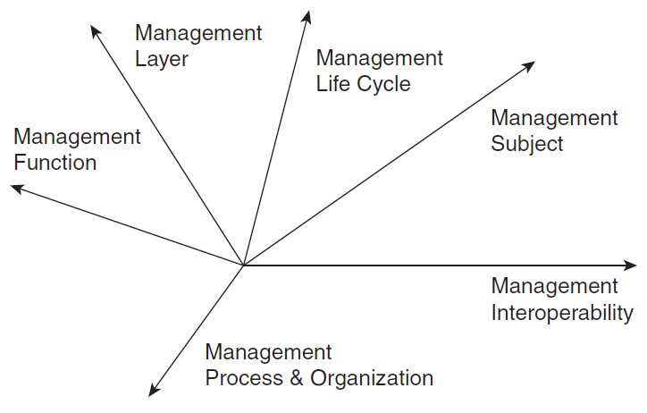
Introduction
Management dimensions
Makes it easier to define a systemic approach to solving a network management problem
: Network

Slide 5
Introduction (cont’d)
Important fact:
These dimensions are (almost) orthogonal
Examples
It does not matter witch technology is managed
The management protocols must be interoperable
It does not matter which layer is managed
The management functionalities are needed

Slide 6
Outline
Introduction
Lifecycle
Interoperability
Layers
Functions
Process & Organization
Summary

Slide 7
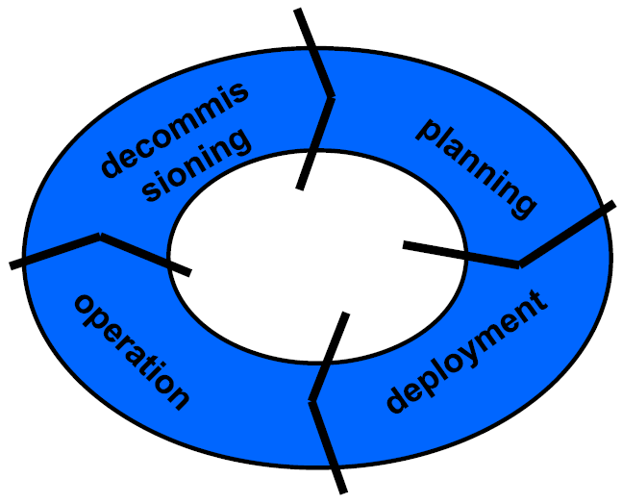
Network Lifecycle

Slide 8
Network Lifecycle (cont’d)
Planning
Forecast user & service needs, equipment selection, topology planning, …
Deployment
Equipment installation and turn-up, physical setup, wiring, logical setup and initial configuration
Operations
What is normally associated with network management
Decommissioning
“Opposite” of deployment, early notification of users if affected, graceful shutdown, cutover of traffic, …

Slide 9
Network Management Lifecycle
While the “network management” mainly implies the activities in the operation phase
However, each step of network lifecycle needs its own management requirements, E.g.,
Network installation & documentation in “Deployment”
Migration planning & implementation in “Decommissioning” phase
Moreover, every technology & service type has the similar lifecycle in a operational network
Network management
To manage the network lifecycle
Is evolved in the lifecycle as a part of network

Slide 10
Outline
Introduction
Lifecycle
Interoperability
Layers
Functions
Process & Organization
Summary

Slide 11
Management Interoperability
NM is a distributed application, hence
A central challenge: How are systems involved in management able to interoperate
Managing systems with managed systems
Layer 3 connectivity is not sufficient → L7 protocols
Management applications with each other
Distribute computing issues
Requires agreed-upon rules for interactions
Standard management interfaces and protocols

Slide 12
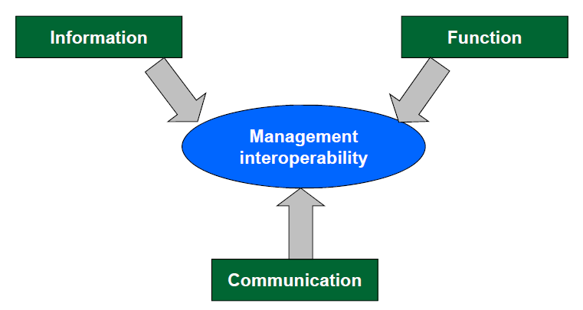
Management Interoperability (cont’d)
Aspects of management interoperability
Notes:
Example: Twp CS students cooperate to solve a problem
They need a common language, e.g., English
They need to agree on which problem they want to solve, what are they doing?
They need to use the same model of the problem, the same context

Slide 13
Communication Viewpoint
NM at the most basic level, is implemented by messages exchanged between managers and agents
Connectivity (e.g. IP) is a prerequisite but not sufficient
IP connectivity: manager and agent can hear each other
Does not mean they speak the same language, or understand each other? Not necessarily!
Generally involves a management protocol
The “common language” between manager and agent
How is a management session established?
What underlying transport do you use?
How do you authenticate?
Notes:
Draw a figure to explain what are needed at each step of communication

Slide 14
Communication Viewpoint (cont’d)
How do you identify the request you have
plus, what parameters are required
How do you recognize a response to a request
Is a time stamp required
plus, what’s the format – there are dozens of them
How is the message encoded
XML? UTF-8?
What if two messages with the same request are received
Execute the same request twice, or ignore?
Who tears down the management session
What happens if a response is not received after a certain amount of time

Slide 15
Function Viewpoint
Describes the services a manager can expect from an agent
Basic services
Retrieve a piece of information
Modify a configuration
Initiate an action
Receive an event
Advanced services (examples)
Transaction support: commit and roll back multiple operations as if they were one
Event subscription: receive only events of interest
Search and filter
Communication protocol defines the message that are being exchanged to perform the function
Advanced functions are implemented through multiple management primitives

Slide 16
Information Viewpoint
The context of network management
A common terminology between manager and agent
Without a common terminology, no management interoperability
Meta model: the modeling constructs at your disposal to define the model by which the managed system is referred to
Object oriented: collection of objects
Data oriented, table oriented: entries and columns of tables
Command oriented: commands and command parameters
Model: the actual representation of a type of managed system e.g. a router, a switch, a voicemail application
Standards specifies the meta model
Model of MOs of an agent is given by vendor
Notes:
Example of programming: Standard (ANSI) defines variables type: int, float, char, … but it does not specify the input/output of all functions in all C libraries. Libraries by them selves define the functions and their input/output parameters (using the standard type)

Slide 17
The Role of Standards
Goal: align the way in which things are managed
It’s all about interoperability
Not an issue if you only manage a single type of thing, but:
Different vendors, Different device types, Different OS
More easily manage different devices
Less time, cost to integrate
What to standardize
Management messages, encoding of information
Functions, parameters, return codes
Management information (typically, meta-models)

Slide 18
NM Standardization Bodies
Numerous standards bodies, sometimes competing
Industry consortia
Companies serving a common market interest
TeleManagement Forum (TMF), DSL Forum, Desktop Management Taskforce (DMTF), …
Professional organizations
Members are individuals of a profession
IEEE, …
Government-sanctioned bodies
ITU-T, ISO, IETF, W3, …

Slide 19
Outline
Introduction
Lifecycle
Interoperability
Layers
Functions
Process & Organization
Summary

Slide 20
TMN: as an example of layering
TMN (Telecommunication Management Network)
It is much more then just a network management layering
Problem
Heterogeneous management systems for heterogeneous technologies
Solution
Standardized management network with aligned management systems for heterogeneous networks
Currently
Has little commercial relevance
Used as reference model
An example of comprehensive management framework

Slide 21
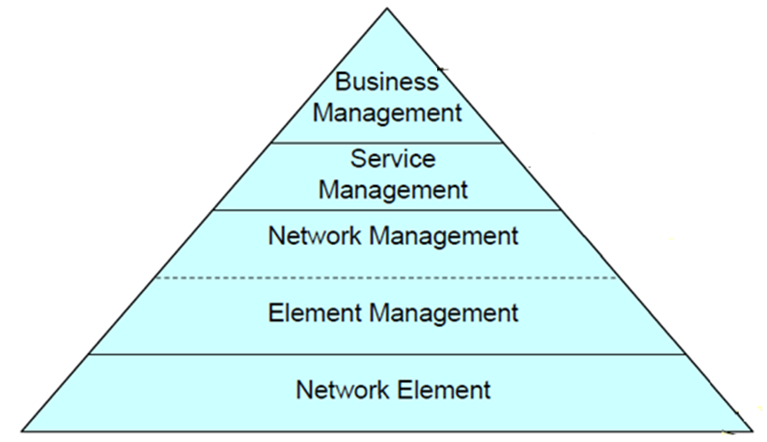
TMN Layers

Slide 22
TMN Layers: Network Element
It is a manageable network device
It means “the management agent”
It provides agent services, mapping the physical aspects of the equipment into the TMN framework
Get management parameters
Set management parameters (configuration)
Alarm generation
…

Slide 23
TMN Layers: Element Management
Vendor specific management functions
Hides these differentiations from the Network Management
Examples of functions
Detection of equipment errors
Measuring power consumption & temperature
Measuring the resources that are being used
Like CPU-time, buffer space, queue length etc.
Logging of statistical data
Updating firmware
…

Slide 24
TMN Layers: Network Management
To manage the functions related to the interaction between multiple pieces of equipment
Involves with keeping the network running as a whole (end-to-end)
Examples of functions
Creation of the complete network view
Creation of dedicated paths through the network to support the QoS demands of end users
Modification of routing tables
Monitoring of link utilization
Optimizing network performance
Detection of faults
…

Slide 25
TMN Layers: Service Management
Is concerned with management of those aspects that may directly be observed by the users of the network
These users may be end users (customers) but also other service providers
Managing the services that the network provides and ensuring those services are running smoothly
Service Provisioning and SLA guarantee
Examples of functions
Quality of Service management (delay, loss, etc.)
Accounting
Addition and removal of users
Address assignment

Slide 26
TMN Layers: Business Management
It is responsible for the management of the whole enterprise
It can better be related to strategical and tactical management
instead of operational management
Examples of functions
Billing and invoicing
Help desk management
Business forecasting
…

Slide 27
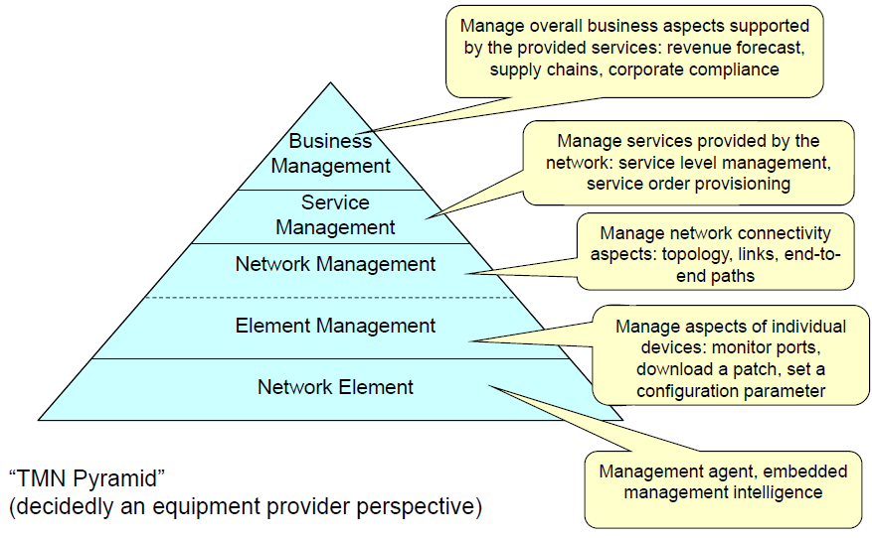
TMN Layers

Slide 28
Considerations
Different layers are often handled by different organizations; example?
Technical layering can influence how a business is structured and define its business relationships
For example, a transport provider might provide physical lines and transmission equipment
Network service providers provide voice or data services, using the transmission services of a transport provider
The multiple-layer approach is sometimes criticized
management solutions consisting of multiple systems each working at a different layer cause an integration difficult, costly system administration

Slide 29
Outline
Introduction
Lifecycle
Interoperability
Layers
Functions
Process & Organization
Summary

Slide 30
Functional Viewpoint
Categorization of different management tasks
Typically share similar characteristics and requirements
Often addressed by management applications
Can be basis for structure of management organizations
Examples of categorization
FCAPS (popular in data world)
Starting point: Common functions/ purposes of management tools
OAM&P (popular in telco world)
Starting point: Common structure of organizations running a network
Other categorizations are possible
E.g. Fulfillment, Assurance, Billing (Telemanagement Forum)
E.g. FCAPS + Change Management (former IBM)

Slide 31
FCAPS: as an example of functions
First articulated in ITU-T TMN Reference Model
Popular in datacomm world
Fault
Configuration
Accounting
Performance
Security

Slide 32
Fault Management
Functions related to dealing with faults in network
Monitoring networks and services for faults
Reacting to faults when they occur
Managing resolution of faults
Being proactive about preventing faults before they occur
Important fault management functions
Alarm management
Fault diagnosis
Trouble ticketing
Proactive fault management

Slide 33
Configuration Management
Functions related to dealing with how network, services, devices are configured
Physical configuration, e.g.
Equipment, line cards, physical connectivity
Logical configuration, e.g.
Protocol settings, logical interfaces, address assignments, numbering plans, …
Important configuration management functions
Inventory
Auditing, Discovery, Auto-discovery
Synchronization
Image management
Backup and restore

Slide 34
Configuration Management: Provisioning
Provisioning: The steps required to set up network and system resources to provide, modify, or revoke a network service “Resources”:
Bandwidth, CPU, Memory, Port assignments, Address assignments (IP addresses, phone numbers, ..), …
Scope:
Individual systems (“equipment provisioning”)
E.g. set up a firewall
Systems across a network (“service provisioning”)
Coordinated configuration changes across multiple systems
Often required to provide an end-to-end service

Slide 35
Accounting Management
Account for usage of communication resources and services
Metering: Measure what has been consumed by whom at what time
Charging: Have the user pay for what has been consumed
Often forgotten but arguably the most important function area of all
No accounting management, no revenue
Even as a user need to know what you pay for

Slide 36
Performance Management
Performance management tasks
Monitoring performance and service levels
Detecting performance trends, degradations
Tuning network for performance
Common support functions
Performance measurements
Accuracy, calibration, sampling considerations as common issues
Collection of performance data
Often, large volumes of data
Sampling as a common technique to address scale concerns
Visualization of large data sets
Charts, histograms, etc

Slide 37
Security Management
Management of security mechanisms, e.g.
ACL management
Consistency between routers on a network
Size of ACLs
Intrusion detection systems
Learning of patterns
How to protect against hitherto unknown patterns
System security, anti-virus, …

Slide 38
Time Horizon
Short-term management
In the scale of minute, second or even (near) real-time & automated
Network monitoring
Fault detection & Performance monitoring
Medium-term management
In the scale of hour(s) & in conjunction with human interaction
Service provisioning, Fault elimination, Performance reporting
Long-term management
In the scale of weeks or even month, mainly performed by human with software assist
Enhance management workflows, future (capacity) planning and strategies

Slide 39
Outline
Introduction
Lifecycle
Interoperability
Layers
Functions
Process & Organization
Summary

Slide 40
Management Organization & Process
The nontechnical dimension of network management, including
How to organize management
The processes that are required to ensure that networks run smoothly and reliably
The function, life cycle, and management dimensions described earlier can provide guidance for organizing management
Standard procedures must be established and followed for the network to run smoothly
A lack of documented standard operating procedures can cause problems because of: Inconsistent configurations, Troubleshooting problems that arise as a result of inconsistencies, …

Slide 41
TOM & eTOM
Telecommunication Operation Map
Enhanced version: eTOM
TOM distinguishes among three life cycle stages – FAB (Fulfillment, Assurance, Billing)
Fulfillment ensure that a service order that was received is carried out
Turning up any required equipment
Performing configuration
Reserving resources
Assurance – includes all activities ensuring that a service run smoothly after it has been fulfilled
Monitoring service for QoS purposes
Diagnosing any faults and repairing
Billing – making sure that services provided are accounted properly and can be billed to the user

Slide 42
Customer
Strategy, Infrastructure & Product
Operations
Strategy &
Infrastructure
Product
Operations
Fulfillment
Assurance
Billing
Commit
Lifecycle
Lifecycle
Support &
Management
Management
Readiness
Marketing & Offer Management
Customer Relationship Management
Service Development & Management
Service Management & Operations
Resource Development & Management
Resource Management & Operations
(Application, Computing and Network)
(Application, Computing and Network)
Supply Chain Development & Management
Supplier/Partner Relationship Management
Enterprise
Management
Strategic &
Brand Management,
Stakeholder & External
Disaster Recovery,
Enterprise
Market Research &
Relations Management
Security & Fraud
Planning
Advertising
Management
Financial & Asset
Human Resources
Research &
Enterprise Quality
Management
Management
Development,
Management, Process & IT
Technology
Planning & Architecture
Acquisition

Slide 43
Outline
Introduction
Lifecycle
Interoperability
Layers
Functions
Process & Organization
Summary

Slide 44
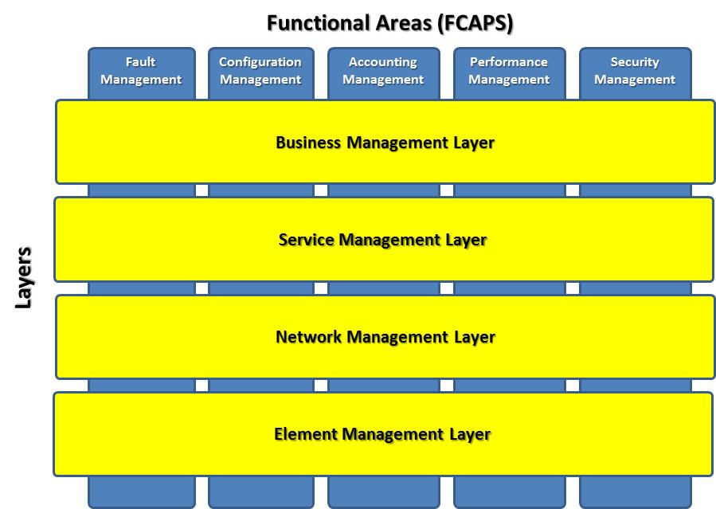
Relation Between Models

Slide 45
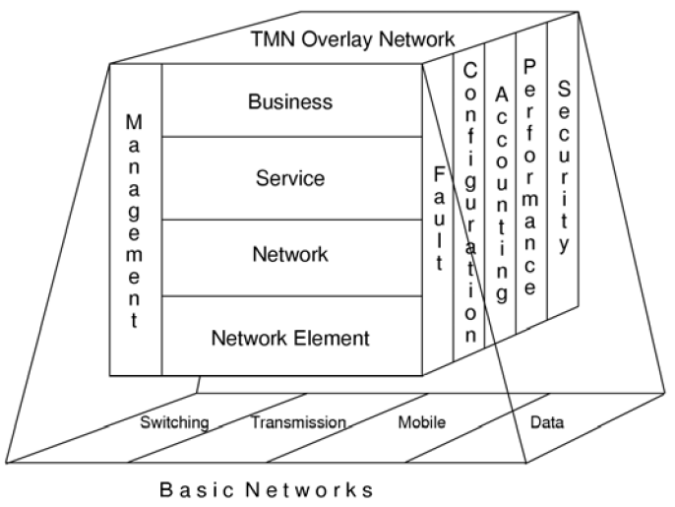
Relation Between Functional Models

Slide 46
Relation Between Models
X: close relation, (X): not close relation, --: very loose relation if at all

Slide 47
References
Reading Assignment: Chapter 4 of “Alexander Clemm, ‘Network Management Fundamentals’ , Cisco Press, 2007”
Alexander Clemm, “Network Management”, Santa Clara University, http://www.engr.scu.edu/~aclemm
Woraphon Lilakiatsakun, “Network Management”, Mahanakorn University of Technology, http://www.msit2005.mut.ac.th/msit_media/1_2553/ITEC4611/Lecture/
Thomas Cavaiani, “Network Management”, Biose State University, http://telecomm.itmbsu.net/itm460.fall.2012/index.html

